Slide 1
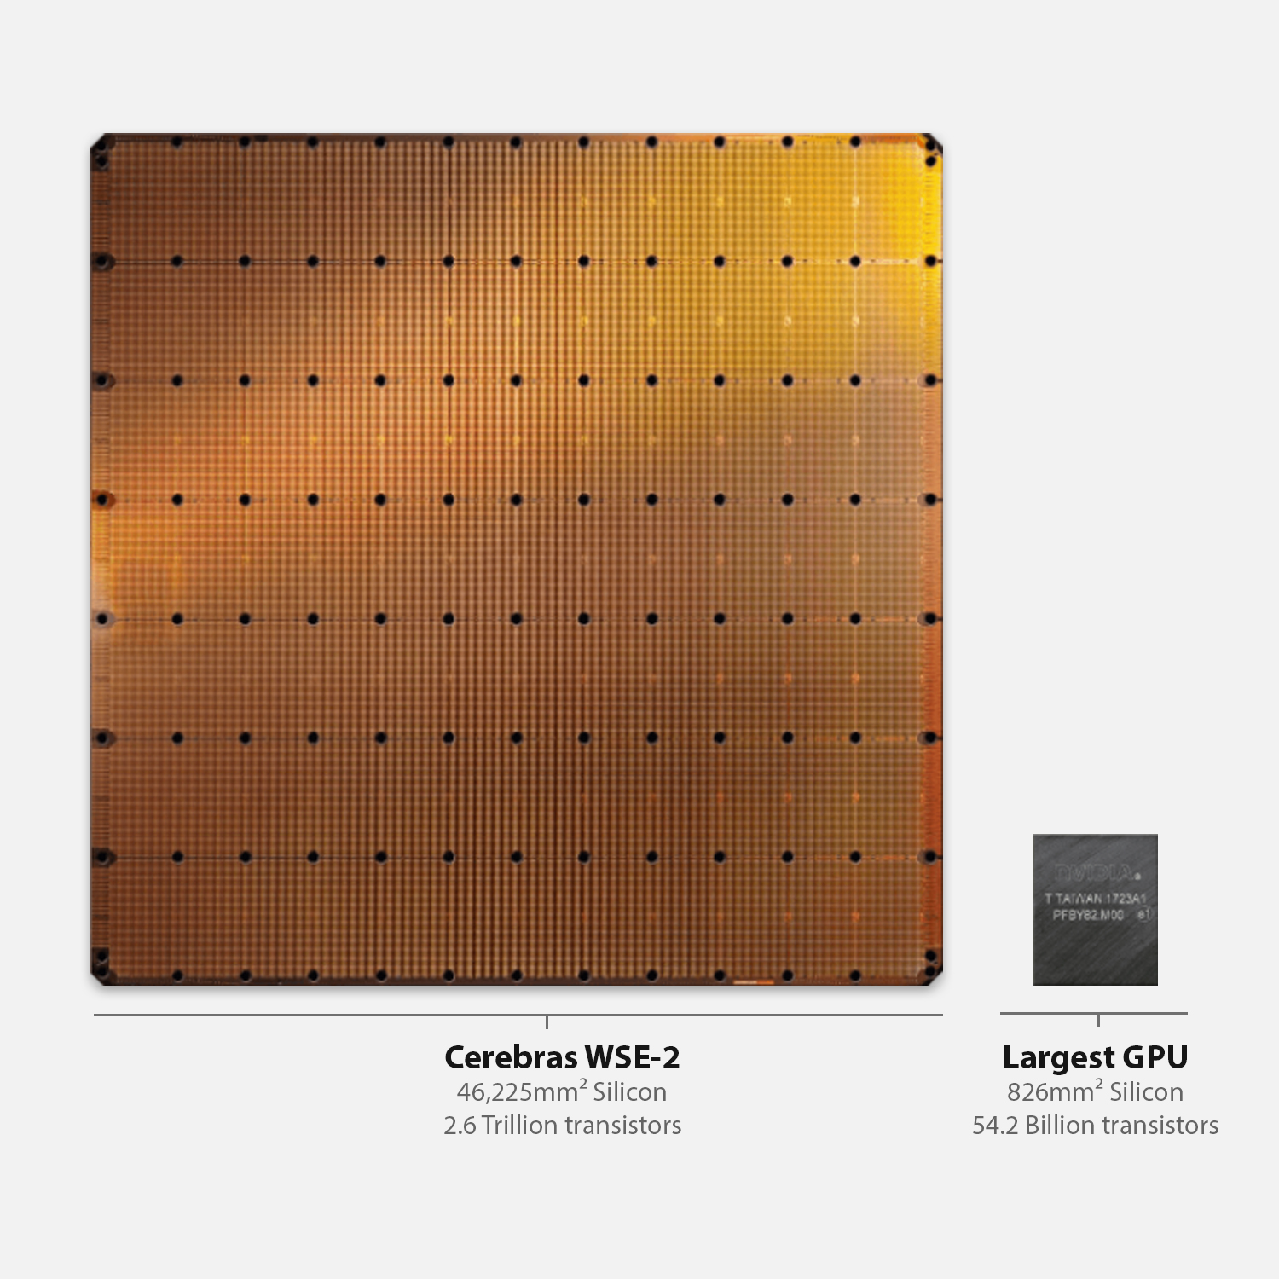



Cerebras SDK walk-through

Slide 2
CSL: Language Basics
Types
Functions
Control structures
Structs/Unions/Enums
Comptime
Builtins
Module system
Params
Tasks
Data Structure Descriptors
Layout specification
Straight from C
(via Zig)
Used for writing device kernel code
Familiar to C/C++/HPC programmers
CSL specific
Notes:
When programming the CS-2 device, you’ll leverage our new CSL programming language
CSL contains common constructs familiar to most programmers and CSL-specific constructs
We’ll cover what some of these look like,
But most users who have written C or C++ should be very comfortable using CSL

Slide 3
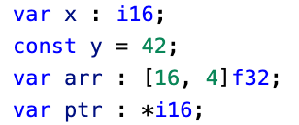
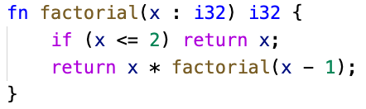
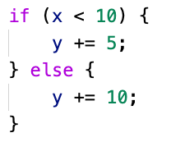
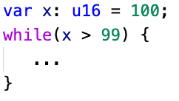
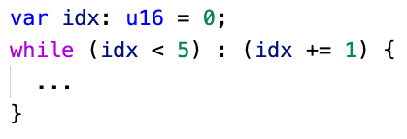
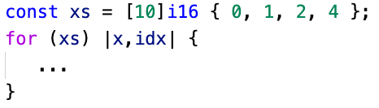
Familiar Features
Types
Syntax similar to other modern languages – Go, Swift, Scala, Rust
Float (f16, f32), signed (i16, i32), unsigned (u16, u32), boolean (bool)
Functions
Zig-style syntax
Pass by value or reference and inlining automatically handled
Control Structures
Traditional control flow: if, for, while, with zig and C style syntax
while loop
while loop with iterator
range for loop
(also provides C-style for)
conditionals

Slide 4
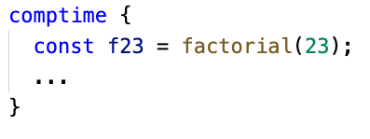
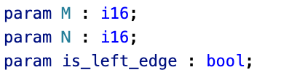
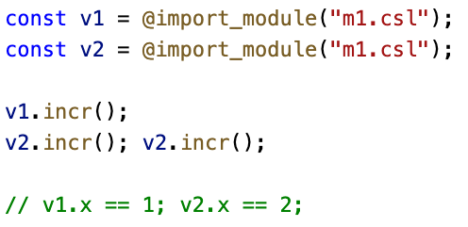
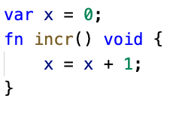
Quality of Life Features
Comptime
From Zig, block of code where all evaluation occurs at compile time
Useful for frontloading computation to avoid runtime overhead
Params
Like #define, but strongly typed
Have to be “bound” completely during compilation
Modules
Any CSL source code file is a “Module,” importable into other modules
Imported modules acts as an instance of a unique struct type
Multiple imports of the same module allowed
p1.csl
m1.csl

Slide 5
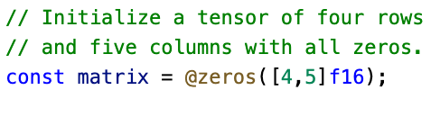
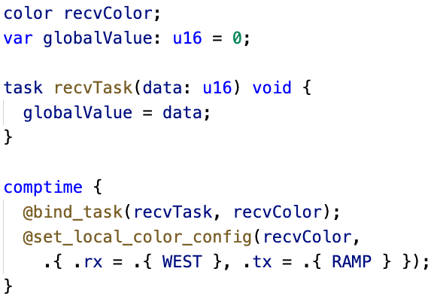
Performance Features
Builtins
Similar to function calls with @ in front of function name
Language extensions without special syntax
Used for invoking special compiler functionality
Tasks
Core building blocks of CSL
Special functions used to implement dataflow programs
Triggered by incoming wavelets on a specific color
var

Slide 6
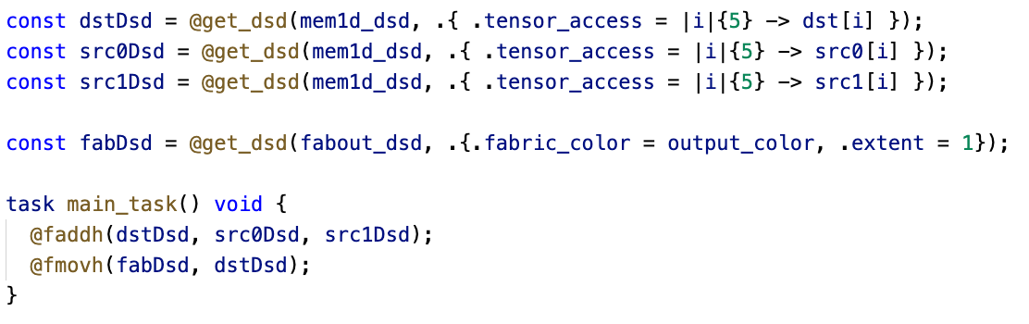
Performance Features
Data Structure Descriptors (DSDs)
Provide a mechanism to consider an array, and an access pattern, as a complete unit
Operations using DSDs run for multiple cycles to complete an instruction on all data referenced by the DSD
Performance and ease of use: lifts level of program to talking about whole structures, while lowering cost of computing indexing into hardware
DSDs are a unifying concept that provides for complex memory reads and writes and fabric reads and writes

Slide 7
Let’s get to programming the machine….
Step one – using the visitor account assigned to you, login to our CS-2 host machine
ssh vistor01@sdf-cs1.epcc.ed.ac.uk
We are now logged into the host machine that connects to the CS-2
Step two – cd into the cs2-sdk-training/practicals/walk-through which we will be working in for this part of the tutorial
[vistor01@sdf-cs1 ~]$ cd cs2-sdk-training/practicals/walk-through
[vistor01@sdf-cs1 walk-through]$ ls
wt1-getting-started wt2-basic-syntax wt3-memcpy wt4-memoryDSDs
wt5-multiple-PEs wt6-routes-fabricDSDs wt7-optimisation wt8-debugging
Let one of the tutors know if you are struggling with this

Slide 8
Running my first CSL program
Change into the wt1-getting-started directory
Compile the code using the cslc command
[vistor01@sdf-cs1 walk-through]$ cd wt1-getting-started
[vistor01@sdf-cs1 wt1-getting-started]$ cslc layout.csl --fabric-dims=8,3 --fabric-offsets=4,1 --memcpy --channels=1 -o out
INFO: Using SIF: /home/y26/shared/cs_sdk-1.0.0/cbcore_sdk-202311111408-10-4a54bce5.sif
compile successful
[nebcs1@sdf-cs1 wt1-getting-started]$ ls out/
bin east out.json west
[nebcs1@sdf-cs1 wt1-getting-started]$ ls out/bin/
out_0_0.elf out_rpc.json
Run (via the simulator)
[vistor01@sdf-cs1 walk-through]$ cs_python run.py --name out
INFO: Using SIF: /home/y26/shared/cs_sdk-1.0.0/cbcore_sdk-202311111408-10-4a54bce5.sif
Congratulations! You have run your first CSL program (although it doesn’t do very much yet!)

Slide 9
What are these arguments to the CSL compiler?
[vistor01@sdf-cs1 wt1-getting-started]$ cslc layout.csl --fabric-dims=8,3 --fabric-offsets=4,1 --memcpy --channels=1 -o out
--fabric-dims=8,3 defines the size of the simulated fabric, which is 8 x 3
--fabric-offsets=4,1 defines where the program is placed on the fabric.
--memcpy this flag is required to enable memcpy within the host program (we discussed this in the architecture slides)
--channels=1 determines the number of ethernet links that can be used to transfer data to/from the CS-2 (maximum of 12)
-o out is the directory where the executables will be saved

Slide 10
What’s this layout.csl?
Defines the layout of the program on the CS-2
[vistor01@sdf-cs1 wt1-getting-started]$ cslc layout.csl --fabric-dims=8,3 --fabric-offsets=4,1 --memcpy --channels=1 -o out
const LAUNCH: color = @get_color(8);
const memcpy = @import_module("<memcpy/get_params>", .{
.width = 1,
.height = 1,
.LAUNCH = LAUNCH
});
layout {
@set_rectangle(1, 1);
@set_tile_code(0, 0, "pe_program.csl", .{ .memcpy_params = memcpy.get_params(0) });
@export_name("init_and_compute", fn()void);
}
Colour (virtual channel) used for Remote Procedure Call (RPC) mechanism
Imports the memcpy module (WSE side of memcpy support) needed to launch kernel
We are using just one PE (columns=1, rows=1)
The lone PE should execute “pe_program.csl” and we pass the memcpy parameters as a parameter
Expose this function “init_and_compute” to the host
In the layout.csl file you will see comments to explain these lines (omitted here for space)

Slide 11
Driving from the host
import argparse
from cerebras.sdk.runtime.sdkruntimepybind import SdkRuntime
# Read arguments
parser = argparse.ArgumentParser()
parser.add_argument('--name', help="the test compile output dir")
parser.add_argument('--cmaddr', help="IP:port for CS system")
args = parser.parse_args()
# Construct a runner using SdkRuntime
runner = SdkRuntime(args.name, cmaddr=args.cmaddr)
# Load and run the program
runner.load()
runner.run()
# Launch the init_and_compute function on device
runner.launch('init_and_compute', nonblock=False)
# Stop the program
runner.stop()
We create an instance of the Cerebras SdkRuntime (the host side library that interacts with the CS-2).
Load our compiled program onto the WSE
Start running the program on the WSE. This won’t do anything yet, it activates and is ready for a Remote Procedure Call (RPC) from the host.
Launch the “init_and_compute” function on the WSE and wait until it has completed
Stop the program on the WSE and clean up

Slide 12
Exploring the pe_program.csl code
// Struct containing parameters for memcpy layout
param memcpy_params: comptime_struct;
const sys_mod = @import_module("<memcpy/memcpy>", memcpy_params);
// Constants defining dimensions of our data
const N: i16 = 3;
// 48 kB of local PE memory contains x and y
var x: [N] f32;
var y: [N] f32;
fn sum(x_ptr : *[N] i16, y_ptr : *[N], value : i16) void
{
…
}
fn initialize() void {
…
}
fn init_and_compute() void {
…
}
comptime {
// Export function so it is host-callable by RPC mechanism
@export_symbol(init_and_compute);
// Create RPC server using color LAUNCH
@rpc(@get_data_task_id(sys_mod.LAUNCH));
}
Infrastructure we need for the memcpy library support
Defines a constant integer of 16 bits
Declares arrays x and y to be of size N and type single-precision floating point. These are allocated in the PE’s local memory
We will look at these functions in detail in a minute
Sets up the program by exporting the “init_and_compute” function
Create an RPC server (so it can be called from the host) using the colour defined in layout.csl

Slide 13
Exploring the pe_program.csl code
Defines sum to be a function with a void return type. It accepts three arguments
The value argument is a scalar of type i16 (16-bit integer). CSL uses a colon to provide type information
fn sum(x_ptr : *[N] i16, y_ptr : *[N], value : i16) void
{
for (@range(i16, N)) |idx| {
y_ptr.*[idx] += value * x_ptr.*[idx];
}
}
x_ptr and y_ptr are defined as pointers of over memory of size N. Like C, the asterisk, *, represents a pointer
This is a for loop, which loops over some array and at each iteration the variable idx contains the loop’s current value
This is very similar to a loop in Python but just with a different syntax.
The in-built range function is used here to provide an array containing 0 to N-1 with each element of type i16. Again this is similar to Python’s range function
The asterisk is used to dereference a pointer, so here we are accessing the idx element of y_ptr

Slide 14
Exploring the pe_program.csl code
This initialise function accepts no arguments and returns no value
fn initialize() void {
for (@range(i16, N)) |idx| {
x[idx] = 1.0;
y[idx] = @as(f32, idx);
}
}
fn init_and_compute() void {
initialize();
sum(&x, &y, 2);
// After this function finishes, memcpy's cmd_stream must
// be unblocked on all PEs for further memcpy commands
// to execute
sys_mod.unblock_cmd_stream();
}
For loop, looping up to N with the idx variable containing the loop value at each iteration
Accesses the global variables x and y, setting x to be the value 1.0 and y to be the current loop value (cast to a 32-bit floating point)
Entry point called by the host
Calls the initialise function followed by sum , with x and y global variables as arguments and the scalar value 2
After the work completes need to do some cleanup on the command stream to ensure can execute further commands

